Slide 2




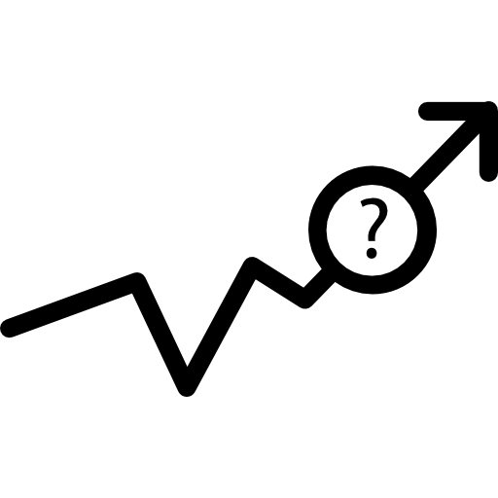
Expert Variable Creation
Since this analysis involves time, with limited data, we chose four different time windows 1, 3, 7, 15 and 30 days. The rationale is to capture more (and different types of) fraudulent records that might be detected in those time windows.
Type I variables are intended to capture unusual amounts of transaction, both at the card level and the merchant level
Type 2 variables are intended to capture unusual transaction frequency during a set period of time, both at the card level and the merchant level
Type 3 are location related variables, which are intended to capture merchants with different zip codes and states in a set period of time.
Type 4 are intended to catch card appearance pattern, either for a merchant or for a card holder.

Slide 3
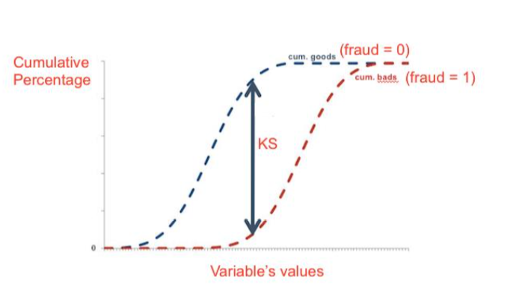
Feature Selection - KS & Lasso
KS
KS is a robust measure of how well two distributions are separated (goods vs bads)
Lasso
Lasso can solve the multicollinearity problem between variables
KS Lasso
130 variables →→ 40 variables →→ 25 variables

Slide 4
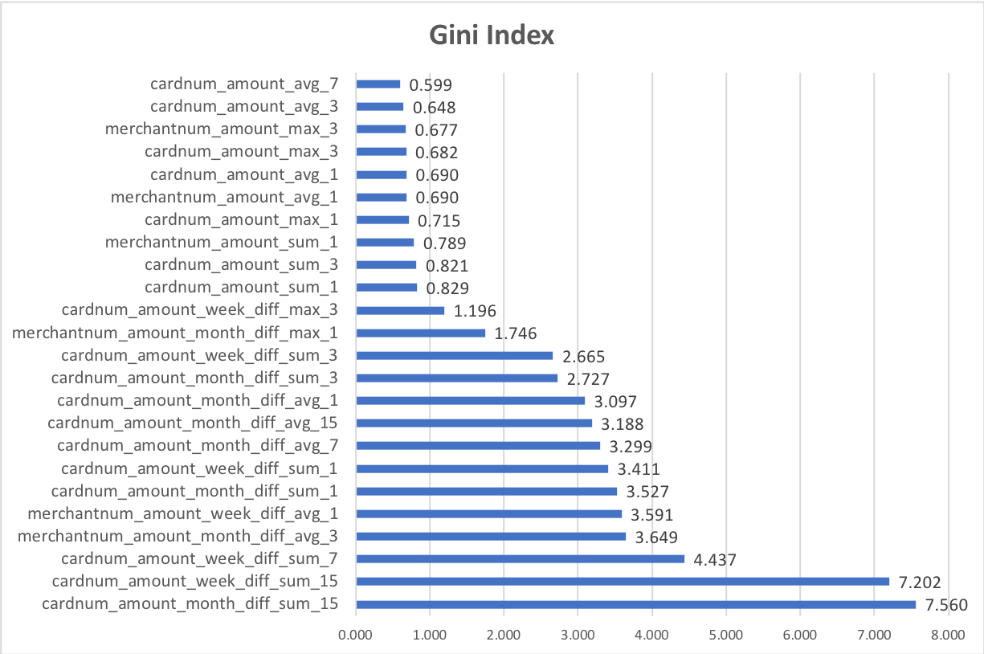
Gini Index – Variable Importance
The Gini coefficient measures the inequality among values of a frequency distribution

